Slide 1
ifconfig Lab
Contributions by Neil Plotnick, Everett High School (Everett, MA)

Slide 2
ip/ifconfig Lab
This lab will explore the ifconfig command in a Linux Terminal
Materials needed
Kali Linux Machine
Software Tools used
ip (Linux Command)
hostname (Linux Command)
ifconfig (Linux Command)

Slide 3
Objectives Covered
Security+ Objectives (SY0-601)
Objective 4.1 - Given a scenario, use the appropriate tool to assess organizational security.
Network reconnaissance and discovery
ipconfig/ifconfig

Slide 4
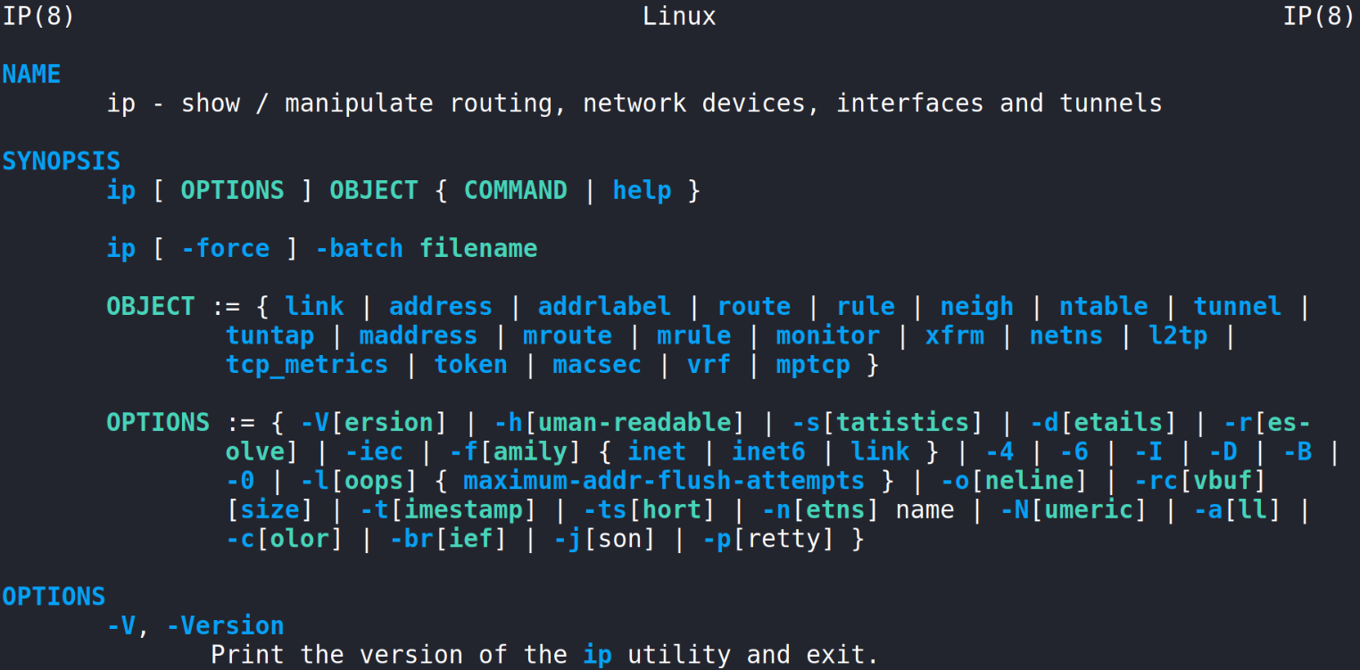
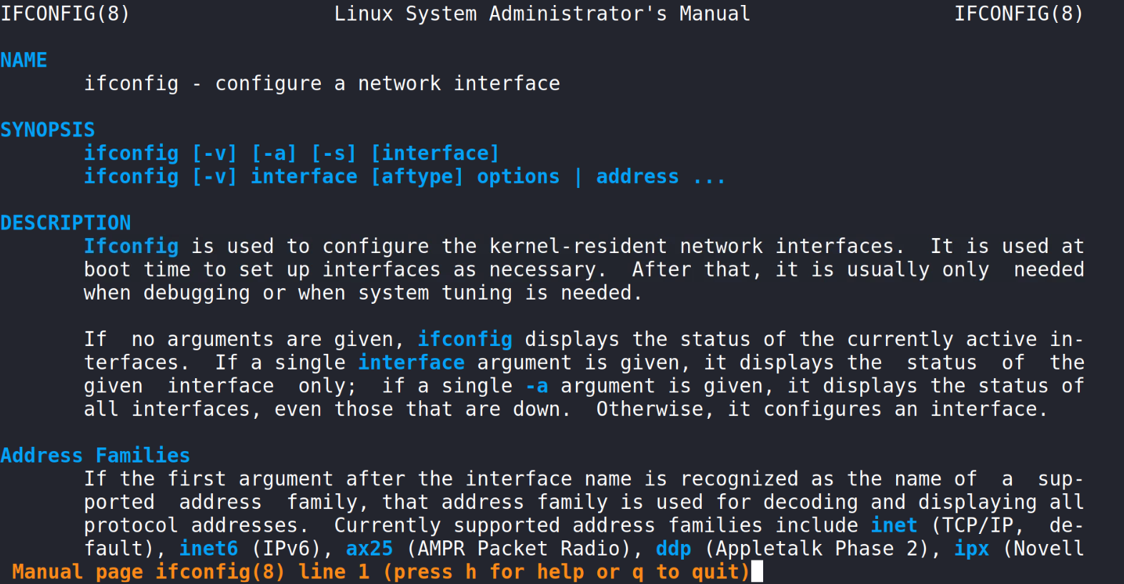
What is ip/ifconfig?
The ip command shows/manipulates the routing, network devices, and interfaces
ip stands for Internet Protocol
The ifconfig command can configure a network interface
ifconfig stands for InterFace CONFIGure

Slide 5
The ip/ifconfig Lab
Setup Environment
The ip Command
The hostname Command
The ip Command (Routes)
The ifconfig Command

Slide 6
Setup Environment
Log into your range
Open the Kali Linux Environment
You should be on your Kali Linux Desktop
Open a new Terminal

Slide 7
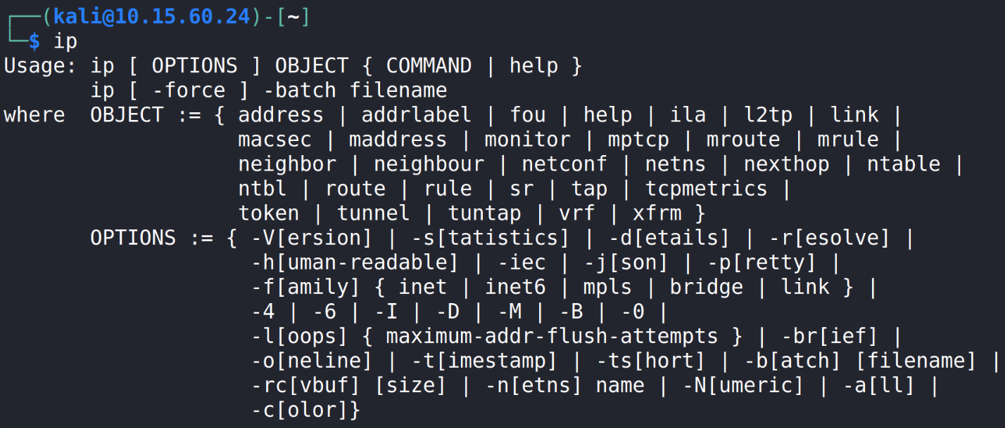
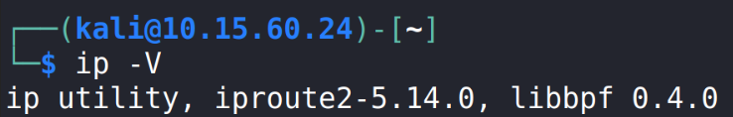
The ip Command
Just entering the ip command will show the following result:
ip
-V for version
Notice all the options, find the current version of the ip utility using “-V”
ip -V

Slide 8
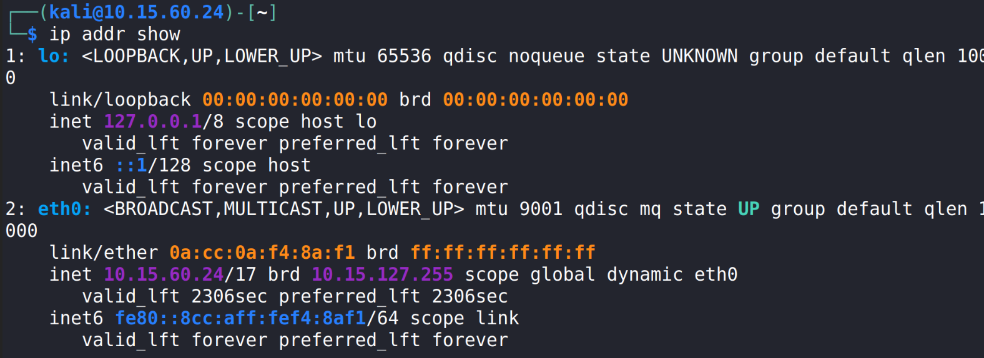
The ip Command
Show the status of various network interfaces of this system
ip addr show
Here, the first network is lo, which is the loopback address
On Linux, this will always be the first address
The address of lo is always 127.0.0.1
The second network is eth0, which shows this has a wired connection
wlan0, would signify it’s a wireless connection
This is where you will find the IP Addresses assigned to the current host
IPv6 Address
IPv4 Address

Slide 9
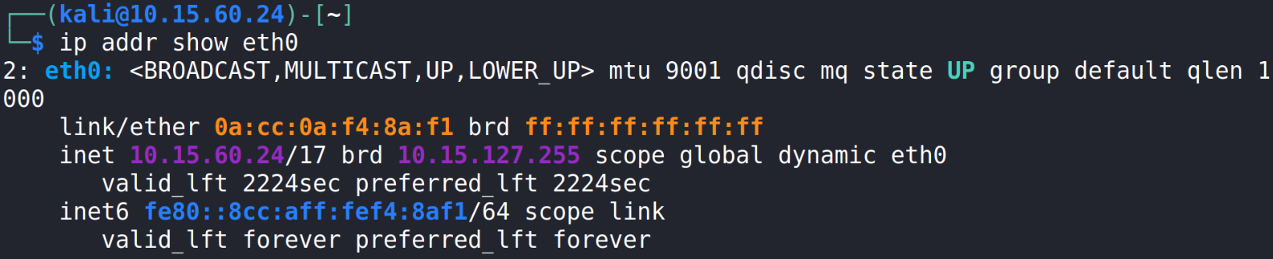
The ip Command
To show the IP address for your network connection
ip addr show <network_name>
Notice the loopback is not displayed. (How might you show the loopback?)
Shorten the results with the -br flag (brief result)
ip -br addr show <network_name>

Slide 10
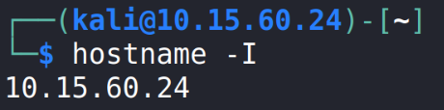
The hostname Command
While the ip command is very powerful, what if you want to show only the assigned IP Address?
Use the following command to show only the IP Address*:
hostname -I
Uppercase i (as in India)
*Note: You may also receive the MAC address with this command!

Slide 11
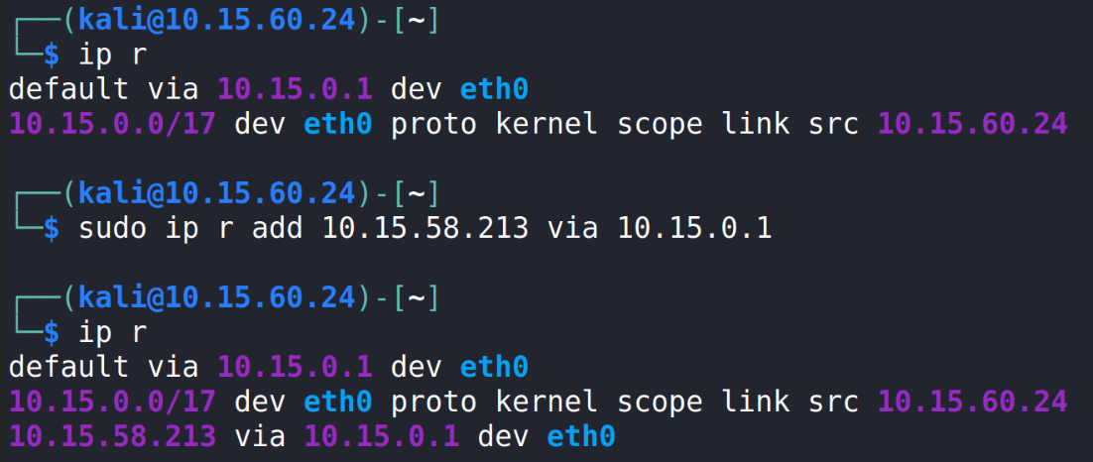
The ip Command (Routes)
List the ip routes
ip r
Add an ip route*
sudo ip r add <New_Route_IP> via <Default_IP>
Show the route
ip r
The new route
*Change add to del to delete the route

Slide 12
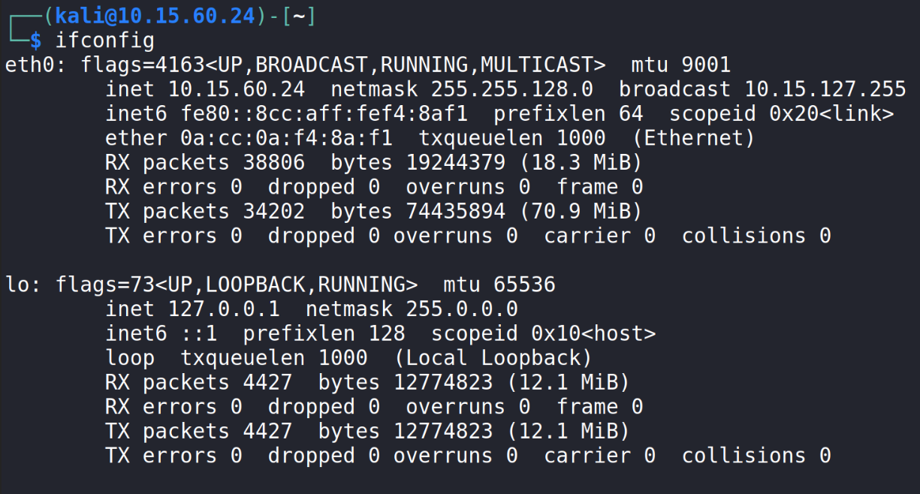
The ifconfig Command
Use the ifconfig command to show the interfaces
ifconfig
Network Connection
IPv4 Address
IPv6 Address

Slide 13
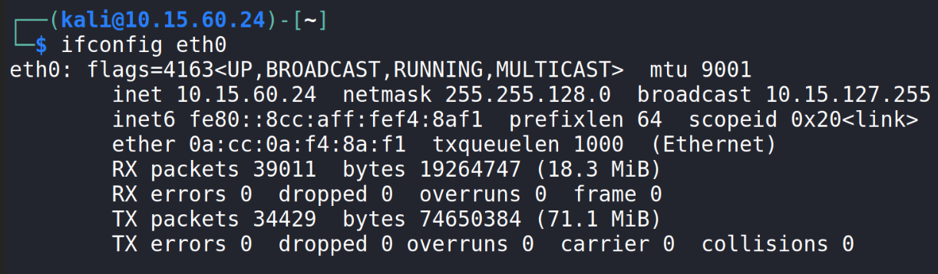
The ifconfig Command
To show stats for a specified network interface:
ifconfig <Network_Name>

Slide 14

The ifconfig Command
The following command will turn a network on
sudo ifconfig <Network_Name> up
The following command will turn a network off
sudo ifconfig <Network_Name> down
Please Note: This will turn the internet connection off, if you are using a cyber range that is utilizing a remote desktop, you will lose access to the system
Turns loopback off
Turns loopback on

